Slide 1
2022 ISCN Conference Day 4 , Panel ‘Embedding Climate Change Education (CCE) within HEIs’

Slide 2
There is a range of published examples/case studies illustrating how CCE is embedded within certain courses/disciplines at universities.
This session seeks to further the debate on:
What are teaching staff attitudes to CEE and what is their knowledge of climate change?
What strategies are more effective in educating students about climate change?
To assist in embedding CEE in curricula, can the existing strategies, initiatives, case studies, etc. be replicated in universities across the globe, and can implementation challenges be addressed/resolved promptly?

Slide 3
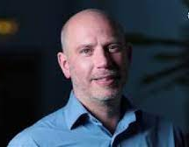
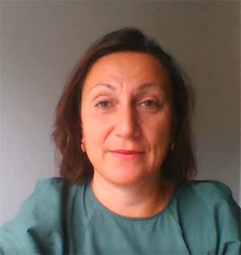
Panel speakers
Professor Petra Molthan-Hill
Professor of Sustainable Management and Education for Sustainable Development
Co-Chair UN PRME Working Group on Climate Change & the Environment
Nottingham Business School, Nottingham Trent University, UK
Prof Dave Reay
Professor in Carbon Management & Education
Exec Director of Edinburgh Climate Change Institute Policy
Director of ClimateXChange
School of GeoSciences, University of Edinburgh, UK
Dr Vitalia Kinakh
Lecturer in Research Methodology in the Division of Dentistry at the University of Manchester.
Member of the Sustainability working group

Slide 4
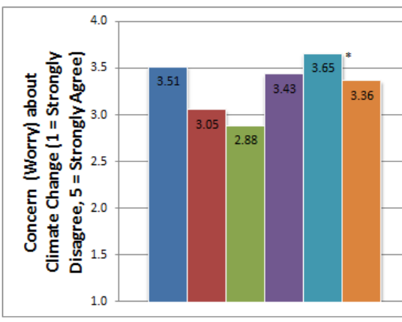
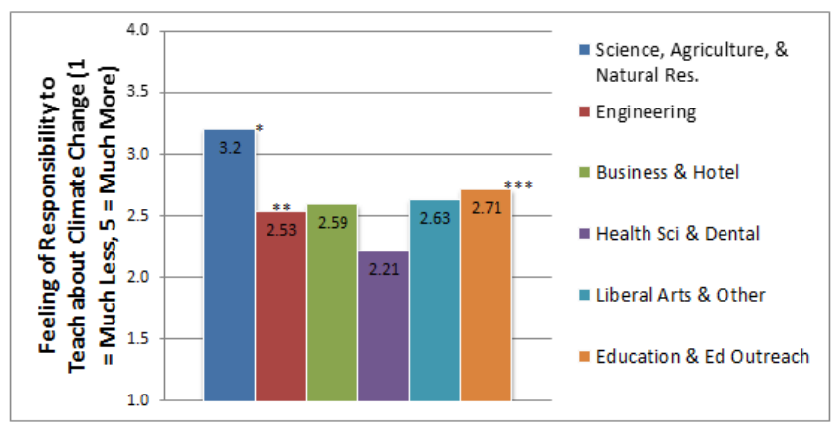
Attitudes of teaching staff to CEE in 2013
Beck, A., Sinatra, G. & Lombardi, D. (2013). “Leveraging Higher-Education Instructors in the Climate Literacy Effort: Factors Related to University Faculty's Propensity to Teach Climate Change.” The International Journal of Climate Change: Impacts and Responses. 4. 1-17.
Notes:
4

Slide 5
Current attitudes of teaching staff to CEE
Important to foster climate-conscious clinicians
Lack of space in the curriculum
There are variations in teachers’ perceptions of what to teach
Staff should be equipped with relevant resources/training and have the capacity to teach climate education
Notes:
5

Slide 6
Effective strategies in educating students about climate change
Approaches to embedding CCE
Adding climate change-related content to the existing curriculum
Individual staff embed climate education in their teaching
Problem-based learning
Service-learning
Writing a reflective piece/doing mini-research projects
Co-curriculum
Elective modules
Notes:
6

Slide 7
Embedding environmental education into the dental curriculum
Individual staff embed climate education in their teaching, e.g.
Sterilization of dental instruments – guidance + discussions how the installation of energy-efficient appliances (e.g. sterilizers) helps reduce energy-related carbon emissions from dental clinics
Training on delivering tobacco cessation advice - mention not only a positive impact on people’s lives, but also a positive reduction in the amount of cigarette butts/nonbiodegradable filters discarded each day.
Notes:
7

Slide 8
Embedding environmental education into the dental curriculum
Mini-research projects by students
An example of Year 2 medical project: “Climate change, air pollution, respiratory illnesses such as asthma and the move from prescribing metered dose inhalers towards dry-powered inhalers.” | → | An example of Year 4 dental project: “An audit of antibiotic prescribing practices and the potential for saving money and reducing a negative environmental impact of disposing unneeded drugs.”
Notes:
8

Slide 9
Embedding environmental education into the dental curriculum
Service-learning (or community-engaged learning) - all year 4 and year 5 dental students given opportunities to work at dental outreach clinics – community partners - often located in deprived and low-income areas
+ 7
Notes:
9

Slide 10
Embedding environmental education in the co-curriculum
Involvement in energy-saving campaigns
Antibiotic awareness events
Glove awareness - appropriate glove use and hand hygiene
Promotion of environmentally-friendly oral care products, e.g. toothbrushes with bamboo handles and mouthwash tablets, during the tooth brushing advice sessions
Certifies for students
Notes:
10

Slide 11
Moving onward
Create collaborative cross-university networks of teaching staff who are working on embedding CCE in curriculum in their subject areas
curating and developing relevant resources
develop a web-based hub with resources
sharing good practice on embedding CCE
Student voice
Universities should collaborate with curriculum regulatory bodies/professional and awarding bodies to ensure that graduates have the skills for UK’s net zero transition

Slide 12
What to adopt some approaches in your university? Please contact vitalia.kinakh@manchester.ac.uk

